Slide 1

Creating Android Apps using App Inventor
By SAM SANOOP (@snoopy_security)

Slide 2


Workshop Overview
Introduction to App Inventor
Setting Up our environment
Writing a Hello World App
Building animations
Drawing canvas
Guess the number game
Calculator
Pong game
The end?

Slide 3
What is App Inventor
Transforms the complex language of android programming into visual, drag-and-drop building blocks
Allows us to create android applications very easily
Can create simple apps, mobile games using a variety of techniques
Imagination is limit!

Slide 4
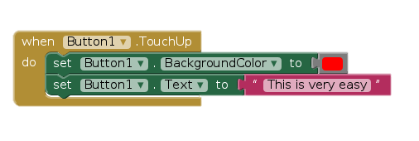
What is App Inventor
App Inventor uses visual blocks to create programs
App Inventor also allows us to access device hardware such as camera and video through various APIs

Slide 5
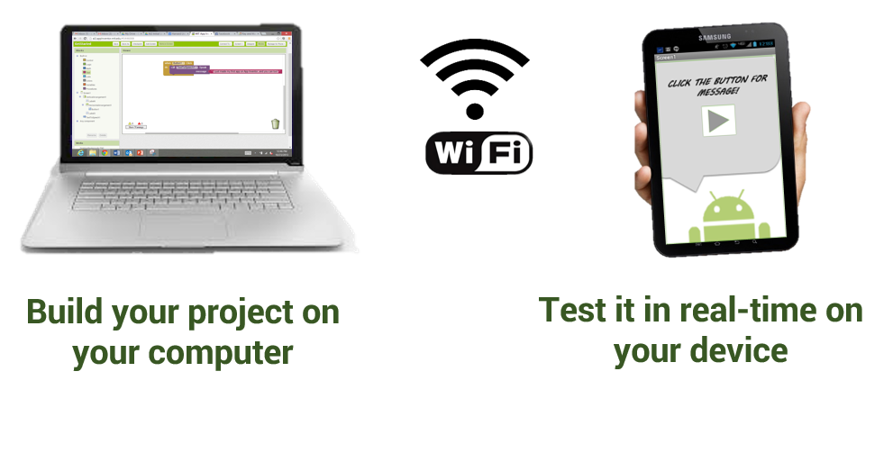
Setting Up App inventor

Slide 6
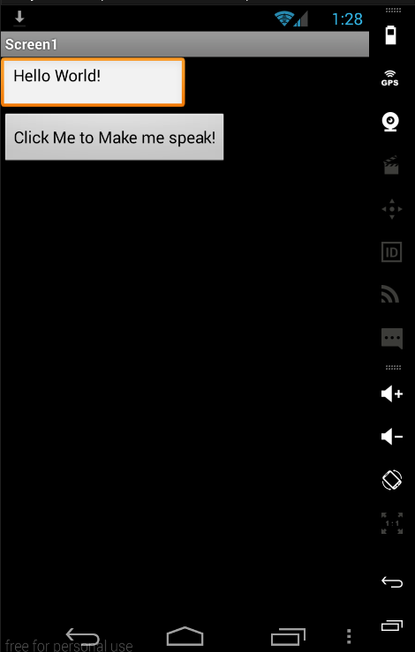
Hello World!
Lets build our first program!

Slide 7

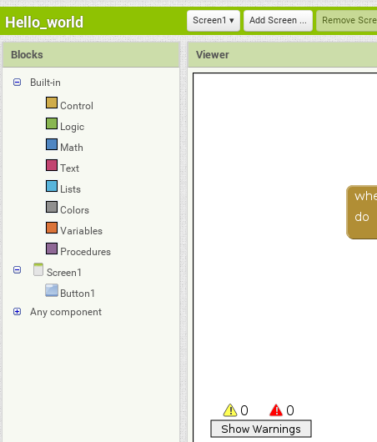
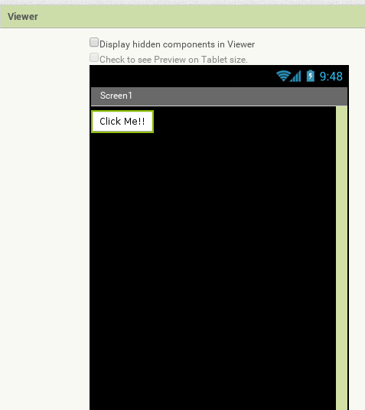
Designer and Block view

Slide 8
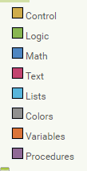
Building code
Blocks are colour coded
All you have to do is put them in order

Slide 9
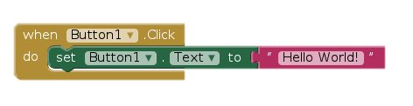
Building code
Blocks have logic
If the logic is wrong, the blocks won’t fit
Code can be saved and reused on other screens

Slide 10
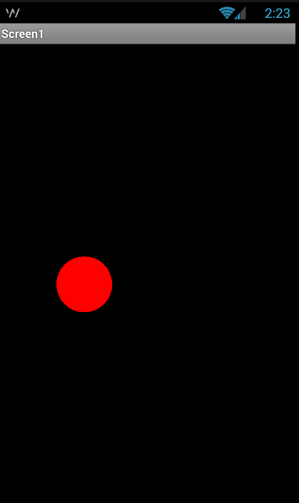
Building animations
Creating Sprites and making them move
Useful when making games

Slide 11
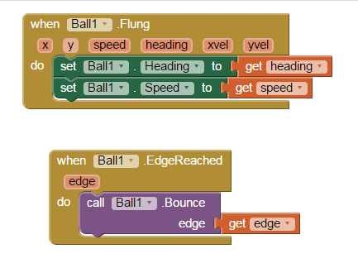
Building animations
Set just increases the heading and speed of the ball every time it is flung

Slide 12
Building animations
Built-in variables can be accessed by selecting the orange block
Useful when trying to access and store variables (more on this later)

Slide 13
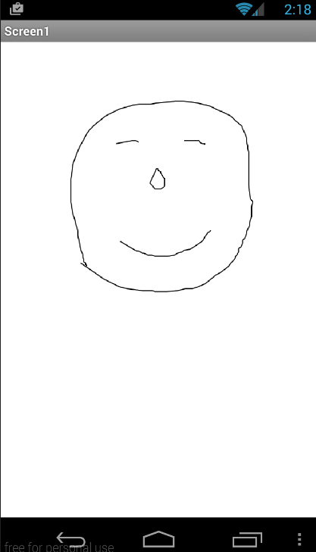
Drawing App
Goal: Make an app that can be used as a drawing pad

Slide 14
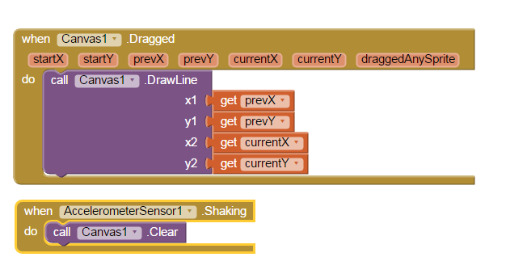
Drawing App
Goal: Make an app that can be used as a drawing pad

Slide 15
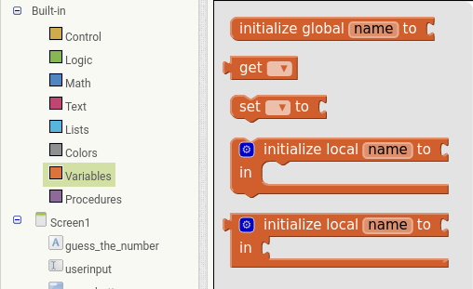
Variables

Slide 16
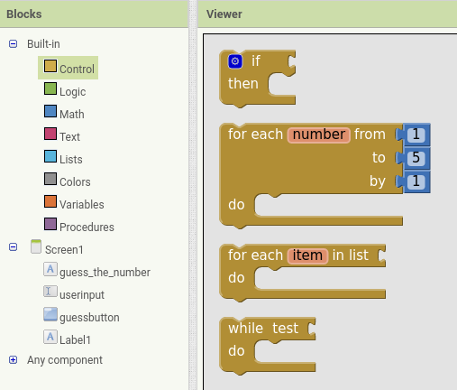
Conditionals and Loops

Slide 17
The road so far
We have used:
Variables
Conditionals
Stored Procedures
Built in functions
And more…..
Same thing, different names

Slide 18
Building our first game
Lets build a ‘guess the number’ game
Computer picks a number between 1 and 10, the user will need to guess it
User is told and the app closes if the correct number is guessed

Slide 19
Lets break it down
Create a screen
Make the program pick a random number
Get the user’s guess
Compare the user’s guess to the program’s number
Close the game when the correct number is guessed
PS: When writing code, always break down your goal into little steps

Slide 20
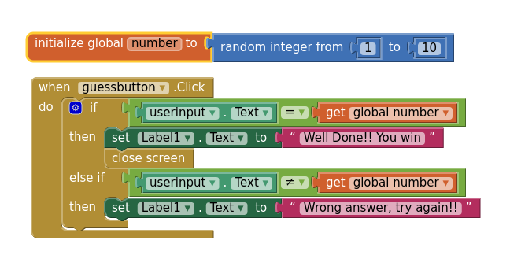
Try it out

Slide 21
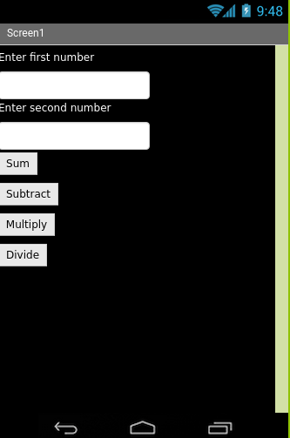
Exercise
Try to create a calculator from
what we’ve learned so far
Remember to break down the app.
Code reuse is highly recommended

Slide 22
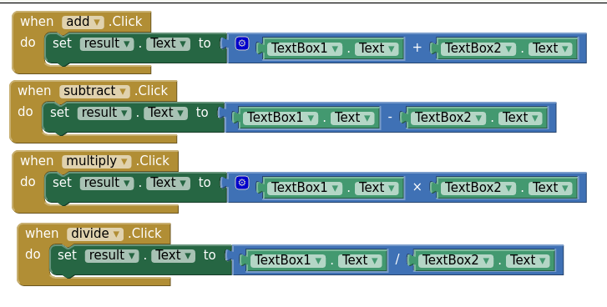
Exercise

Slide 23
Bored yet?; let’s make a real game

Slide 24
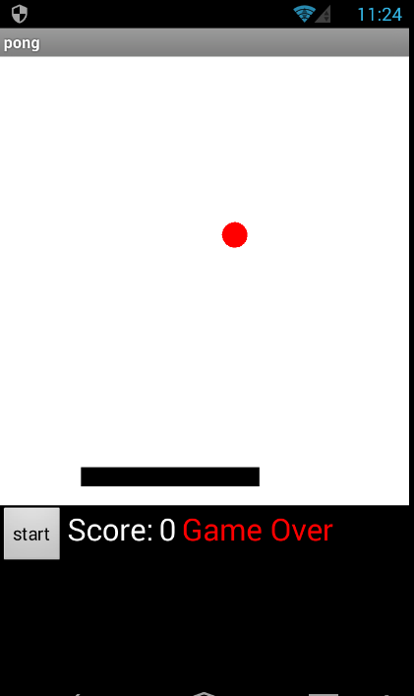
Pong Game
A pong game where the player has to keep hitting the ball which increases his score.

Slide 25
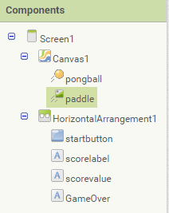
Lets break it down
Lets start by building a screen and adding the necessary components

Slide 26
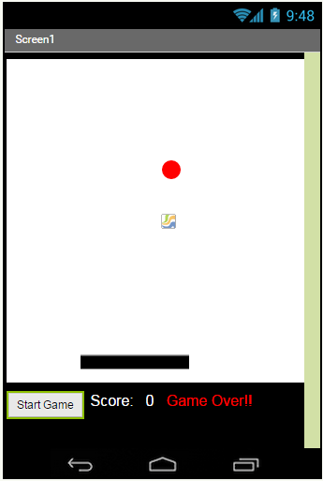

Slide 27
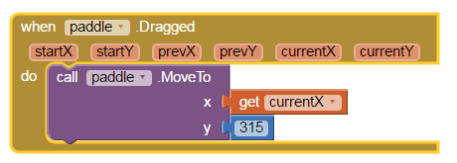
Paddle movement
Why is y axis 315?

Slide 28
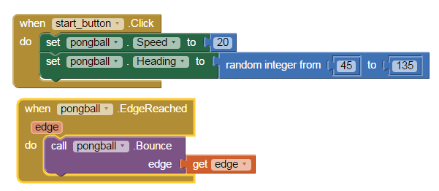
Making the ball move

Slide 29
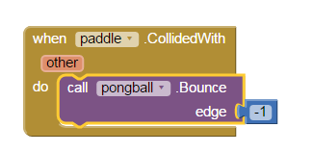
Making the collision happen

Slide 30
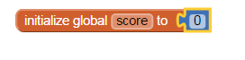
Counting scores
Variables!!!!!

Slide 31
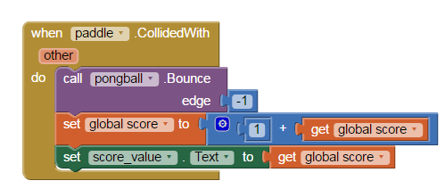
Counting scores
Variables!!!!!

Slide 32
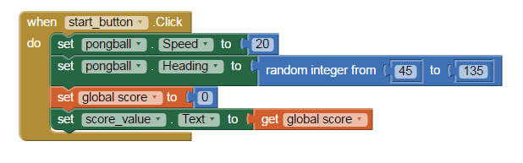
Forgot something
Emptying score at start of the game

Slide 33
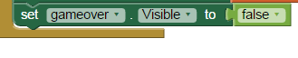
Game over label
Booleans

Slide 34
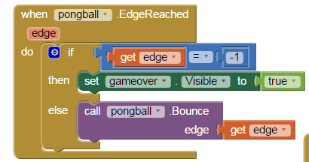
Game over label
Using if statements to check if the ball hits the edge

Slide 35
Game over label
Using if statements to check if the ball hits the edge

Slide 36
The END
Thank you for partaking in this workshop
Any questions? Tweet me at snoopy_security
Workshop materials will be available at https://github.com/snoopythesecuritydog/Public/tree/master/Presentations

